Slide 1


Borrower’s Climate Risk Trend Analysis
Towards sustainable future and effective operation
Presentation content and design by:
Adhiana Elti Evianty

Slide 2

Background
In 2024, the Financial Services Authority (OJK) announced the requirement for all banks to factor climate risk, such as carbon emissions, into lending decisions by 2026. This was intended to align Indonesia’s financial activity with ESG-oriented financial practices. Adding to the green transition and implementation trend in the banking industry.
By the upcoming year. The green transition is expected to become stricter with more regulations and ESG demand from society. Leading ESG practices to become the core driver for operational and financial decision across industries.

Slide 3

Business Impact
Failure to integrate climate-risk lending assessment may expose banks to risks such as:
Regulatory penalty risk
Reputational Damage
Long-term portfolio instability
Hence why, integrating ESG can become an effective risk management strategy to increase overall brand image, stakeholders’ confidence, sustainable portfolio quality, and profitability in the long term.

Slide 4

Current Challenges
The banking industry is still newly adjusting with the implementation of green transition to its lending decisions. Some of the biggest banks have already adapted their lending systems to keep pace with ESG trends and regulations. Yet, the biggest challenges still remain:
Companies lack the data, expertise, and resources needed for banks to execute climate risk and lending assessments.
The integration of climate-risk assessment also increases operational complexity, requiring banks to evaluate additional sustainability-related documentation and indicators.
Potential increases of:
Human error
Screening Time
Operational Cost

Slide 5

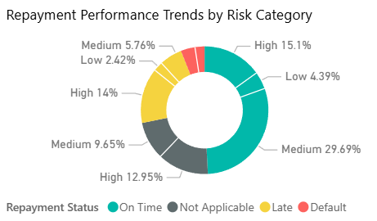
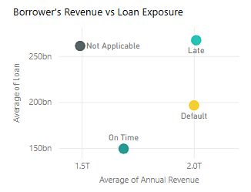

Key Findings
Borrower’s data was analyzed to identify portfolio risk and lending patterns.
The analysis found that:
1. High-risk, high-emission industries contribute the most to late and default repayment.
Borrowers in sectors such as mining, cement, and palm oil show higher climate-risk scores and a lower approval rate. This suggests that lending criteria should be tightened for high-risk industries.
2. Borrowers with higher revenue are not always lower risk.
Several high-revenue borrowers still showed late or default repayment behavior, especially in carbon-intensive sectors. This suggests that revenue alone may not be sufficient to assess repayment reliability, and cash flow assessment should be strengthened.
3. Rejected borrowers represent a significant amount of forgone interest revenue.
The potential interest revenue lost from rejected applications is substantial, indicating that the bank is likely prioritizing climate-risk compliance and long-term portfolio quality over short-term revenue.
Source: Power BI
Overall, the portfolio appears relatively healthy because most borrowers are still repaying on time.

Slide 6

Proposed Solution
ESG-Integrated Lending Decision Support System
Purpose
Automate initial borrower screening
Support ESG-compliant lending decisions
Reduce manual assessment effort
Improve consistency and risk visibility
Assessment Factors
Climate Risk Score
Carbon Emission Profile
Financial Stability Indicators (Cash Flow, Liquidity, Revenue etc)
Repayment History
Loan Exposure
System Recommendation
Approve
Conditional Approval
Monitor
Reject
Final Decision
Credit officer reviews recommendation and determines final lending outcome.

Slide 7
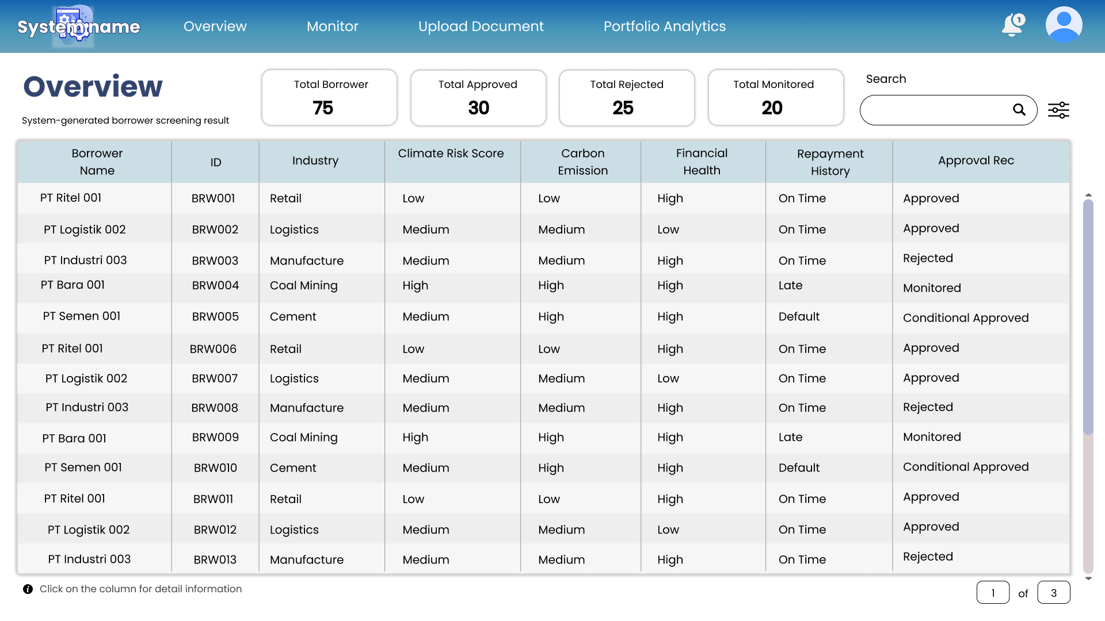
System Interface Mockup
(final design is still in progress)

Slide 8

Process Flow Diagram
Upload Document
AI Assessment
Risk Categorization
Human Review
Final Decision

Slide 9
THANK YOU
Email: adhianaeviantyy@gmail.com
Linkedin: Adhiana Elti Evianty
Github:

